Slide 1

REQUIREMENT ANALYSIS & DESIGN (RAD)
GENERAL CONFEDERATION OF LABOR OF VIETNAM
TON DUC THANG UNIVERSITY
FACULTY OF INFORMATION TECHNOLOGY
JEWELRY ONLINE SALES SYSTEM

Slide 2
Introduction
Shopping has long been considered a recreational activity by many. Shopping online is no exception. The goal of this application is to develop a web based on interface for online retailers. The system would be easy to use and hence make the shopping experience pleasant for the users.

Slide 3
Actor
Web Customer:
New Customer: will be an official customer and can order after successful registration.
Register Customer: customers registered as official members and are allowed to place orders
Shop Owner: perform product management and have the right to add, delete, edit that related to the staffs as well as he can register account and review report of clerk

Slide 4
Actor
Clerk: has function as sales, payment and product management after measuring the report every day to the shop owner.
Credit Payment Service: provide payment services to the store by credit card
PayPal: provide payment services to the store by Paypal.
<<Service>>Authentication: this is a service use to authenticate the credentials, usually account names and passwords of customer.

Slide 5
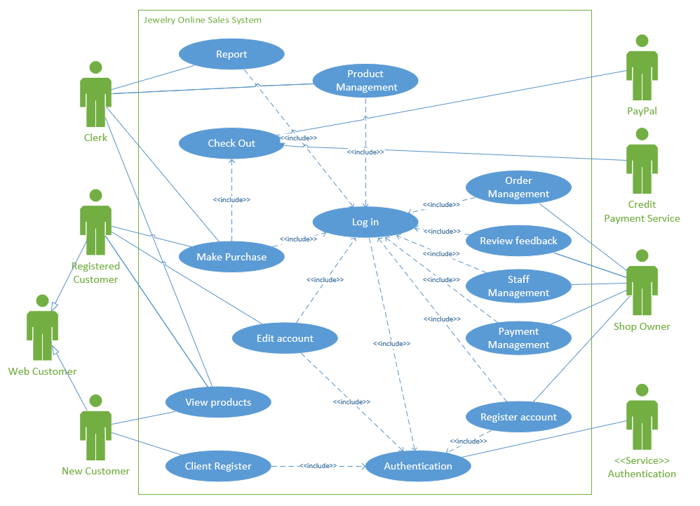
Use case Diagram
This is the use case diagram for Jewelry online sales system.

Slide 6
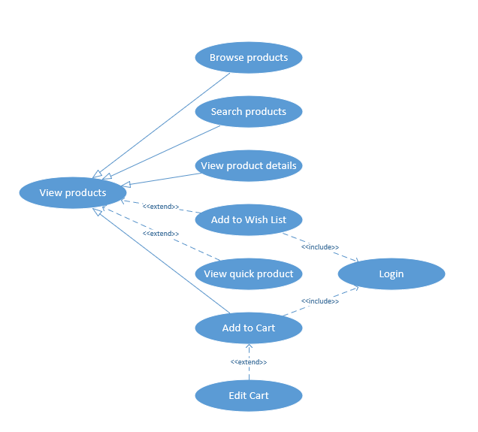
Use case Diagram
This is sub use case diagram for View products.

Slide 7
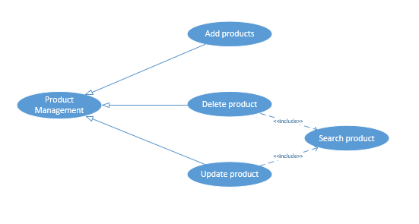
Use case Diagram
This is sub use case diagram for Product Management

Slide 8
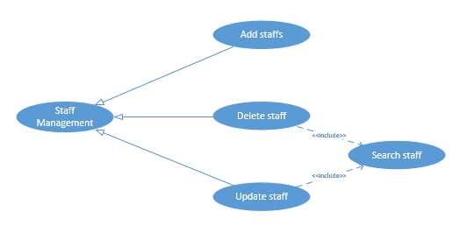
Use case Diagram
This is sub use case diagram for Staff Management

Slide 9
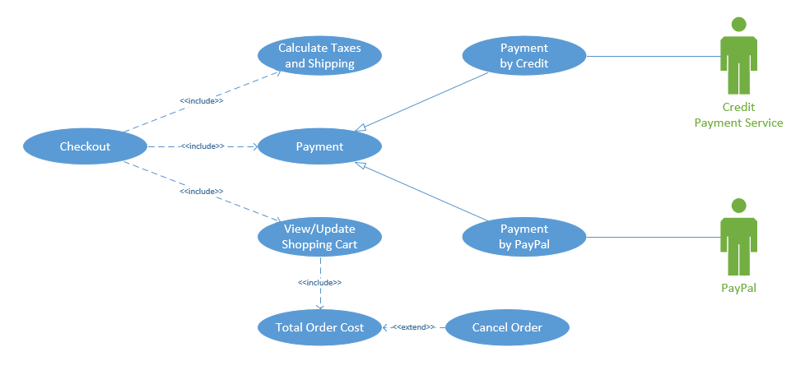
Use case Diagram
This is sub use case diagram for Checkout

Slide 10
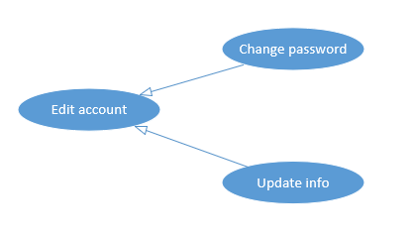
Use case Diagram
This is sub use case diagram for Edit account

Slide 11
List of Use case
There are 14 top level use cases: View products, Client Register, Edit account, Make Purchase, Checkout, Report, Product Management, Login, Authentication, Register account, Payment Management, Staff Management, Review feedback, Order Management.

Slide 12
Use case detailed description
Use case U100 view products
Description: This use case describes how the users can search and view products.
Primary Actor: Web customer and Clerk
Priority: Must have
Trigger: None
Pre-Conditions: Users opened the web.
Post-Conditions: Customers or Clerk find and view products.
Flow of Events:
Basic Flows:
1.User opens a web browser, gives the URL and clicks on ‘Enter’ button.

Slide 13
Use case detailed description
Use case U100 view products
2. System launches the web site.
3. User enters text in text box next to Search button and clicks on Search button.
4. System displays the matching text products.
5. User clicks on the desired link. User can navigate back to the earlier pages if wishes.
Alternate Flow:
3a. If search returns no results, System displays the message “No matches found for the entered text”.
Exception Flow: System displays the error messages.

Slide 14
Use case detailed description
Use case UC200 Client Register
Description: This use case describes how the users can search and view products
Primary Actor: New Customer
Priority: Should have
Trigger: Users click on “Register’ button
Pre-Conditions: Users opened the web.
Post-Conditions: User register new account
Flow of Events:
Basic Flows:
1. The use case are started when user clicked on register button
2. System show register form

Slide 15
Use case detailed description
Use case UC200 Client Register
3. User fill all information in form
4. System check username is already exists
5. System check password to meet condition
6. System display message “Sign Up Success”
Alternate Flow:
4a. If username is already exists, display message “Username is already exits, please re-enter other username”
5a. If password doesn’t meet condition, display message “Password has at least 8 characters and includes letters and numbers
Exception Flow: System displays the error messages

Slide 16
Use case detailed description
Use case UC300 Edit account
Description: This use case describes how the users can edit account information edit the account information except the username
Primary Actor: Customer, Clerk
Priority: Could have
Trigger: User click on “Edit Account” button
Pre-Conditions: User opened “Manage my account” site, user must login
Post-Conditions: User edit account information
Flow of Events:
Basic Flows:
1. The use case started when user click on edit “Edit” button
2. User click on change button

Slide 17
Use case detailed description
Use case UC300 Edit account
3. System check each information that user changed
4. User confirm to change information
5. …
Alternate Flow:
3a. If that is password, system send the confirm form to user email and display message “Please check email and click on link in there if you confirm information is correct”.
3b. If that is email, system send the confirm form to user email and display message “Please check email and click on link in there if you confirm information is correct”.

Slide 18
Use case detailed description
Use case UC300 Edit account
3c. If that is other information, system display confirm form in site.
4a. User click on link confirm in their email.
4b. User click on button confirm in confirm form is displayed in site
Exception Flow: System displays the error messages

Slide 19
Use case detailed description
Use case UC400 Make Purchase
Description: This use case describes how the users can make purchase or add product to their cart
Primary Actor: Customer, Clerk
Priority: Must have
Trigger: users has added product into cart
Pre-Conditions: The website is opened, user must login and cart contained product
Post-Conditions: User choose product that they need.

Slide 20
Use case detailed description
Use case UC400 Make Purchase
Flow of Events:
Basic Flows:
1. The use case started when user click on “add to cart” button
2. System check product that is chosen by user is available
3. System display animation to move product’s icon on cart’s icon.
Alternate Flow:
2a. If product is not available in the stock, display message “This product are sold out”
Exception Flow: System displays the error messages

Slide 21
Use case detailed description
Use case UC500 Checkout
Description: This use case describe how user check out after make purchase
Primary Actor: Customer, Clerk
Priority: Must have
Trigger: When users added products to cart and click on “checkout” button
Pre-Conditions: User must make purchase with least one product, user must login
Post-Conditions: User want to checkout
Flow of Events:
Basic Flows:
1. The use case started when user move on their cart and click on “Checkout” button

Slide 22
Use case detailed description
Use case UC500 Checkout
2. Display total amounts and all products that user add to their cart
3. User check quantity of each product, they can change it
4. System check quantity of each product
5. User click on “Confirm” button to confirm information of bill and address(shipping)
6. Display message “Checkout is success”
Alternate Flow:
4a. If quantity of each product is changed, update total amounts and quantity
Exception Flow: System displays the error messages

Slide 23
Use case detailed description
Use case UC600 Report
Description: This use case describes how to user can export the report
Primary Actor: Clerk
Priority: Should have
Trigger: when Clerk click on “Report” button
Pre-Conditions: User must stay on the Manage store site, user must login
Post-Conditions: User want export the report of all bill
Flow of Events:
Basic Flows:
1. The use case is started when use click on export button
2. System displays information of report in screen (default is daily report)

Slide 24
Use case detailed description
Use case UC600 Report
3. User changes the type of report to export
4. The system checks the type of report to export
5. Export pdf file of report and display message “Success”
Alternate Flow:
4a. If the report type to export is monthly, update the information on the screen
4b. If the report type to export is quarterly, update the information on the screen
4c. If the report type to export is yearly, update the information on the screen
Exception Flow: System displays the error messages

Slide 25
Use case detailed description
Use case UC700 Product Management
Description: This use case describes how user can manage the product
Primary Actor: Clerk
Priority: Must have
Trigger: When users go to dashboard page
Pre-Conditions: User must stay on the Manage store site, user must login
Post-Conditions: User want update of add new product to store
Flow of Events:
Basic Flows:
1. This use case is started when use click on manage button.
2. User choose management option by click on add, delete, edit product button

Slide 26
Use case detailed description
Use case UC700 Product Management
3. System check option that user chose.
4. Display change confirm form.
5. User confirm in form.
Alternate Flow:
3a. If user choose add option, start add use case
3b. If user choose delete option, delete add use case
3b. If user choose edit option, delete add use case
Exception Flow: System displays the error messages

Slide 27
Use case detailed description
Use case UC800 Login
Description: This use case describe how to user can login to website
Primary Actor: Customer, Clerk, Shop owner
Priority: Should have
Trigger: When users click on “Login” button
Pre-Conditions: The website is opened
Post-Conditions: User login to use any function in website
Flow of Events:
Basic Flows:
1. The use case are stated when user click login button or use more other use case as make purchase, checkout, report, ….

Slide 28
Use case detailed description
Use case UC800 Login
2. System display login form
3. User enter username and password into login form
4. System check username and password are valid
5. User click on login button
5. Display the previous screen
Alternate Flow:
4a. If information is valid, display message “Successfully”
4b. If information is invalid, display message “Username or password is incorrect, Please re-enter once”
Exception Flow: System displays the error messages

Slide 29
Use case detailed description
Use case UC900 Register account
Description: The use case describer how to create new account for Clerk
Primary Actor: Shop Owner
Priority: Must have
Trigger: When Shop owner click on “Create new account” in dashboard page
Pre-Conditions: Website is opened, user must login successfully
Post-Conditions: User want create new account for clerk
Flow of Events:
Basic Flows:
1. The use case is started when user click on button create clerk account

Slide 30
Use case detailed description
Use case UC900 Register account
2. System show register form.
3. User enter all information that form required
4. System check username is already exists
5. System check password to meet condition
6. User click on register button
7. Display message “ register successfully”
Alternate Flow:
4a. If username is already exist, display message “Username is already exits, please re-enter other username”
5a. If password doesn’t meet condition, display message “Password has at least 8 characters and includes letters and numbers
Exception Flow: System displays the error messages

Slide 31
Use case detailed description
Use case U100 view products
Description: This use case describer how to edit, delete clerk account
Primary Actor: Shop Owner
Priority: Must have
Trigger: When Shop owner go to dashboard page
Pre-Conditions: Website is open, user must login
Post-Conditions: User want to edit or delete clerk account
Flow of Events:
Basic Flows:
1. The use case is started when user lick on button staff manage
2. Display staff manage screen
3. User choose manage option in manage screen

Slide 32
Use case detailed description
Use case U100 view products
4. System check the option that user chose
5. System display confirm form
6. User click on confirm button
7. System display message “Change will be apply”
Alternate Flow:
4a. If user choose edit option, system will implement staff account edit use case
4b. If user choose delete option, system will implement staff account delete use case
Exception Flow: System displays the error messages

Slide 33
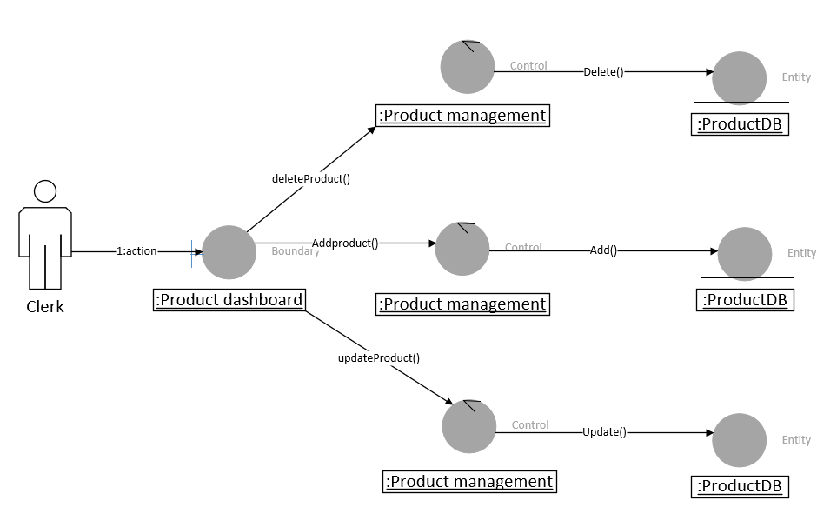
Collaboration Diagram
Collaboration diagram
for product
management

Slide 34
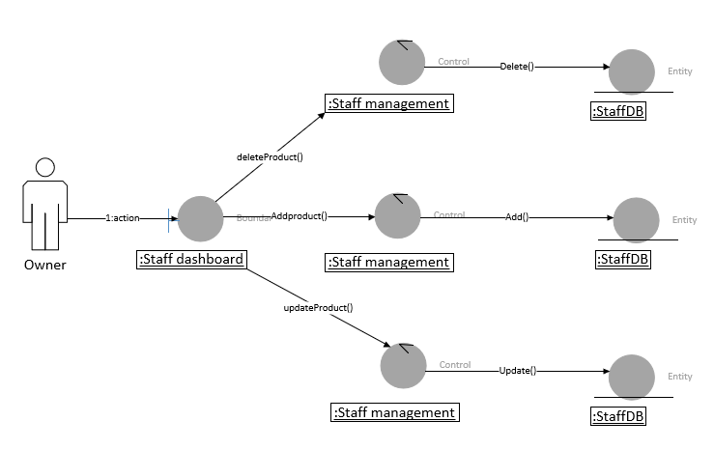
Collaboration Diagram
Collaboration diagram
for staff managment

Slide 35
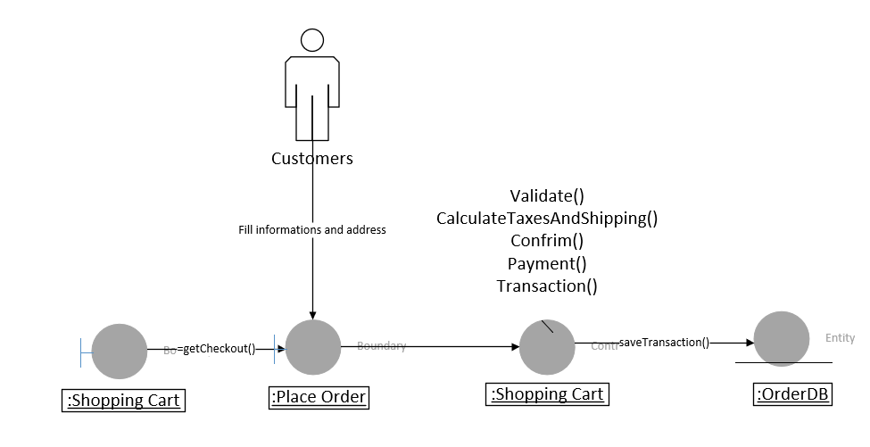
Collaboration Diagram
Collaboration diagram
for purchase

Slide 36
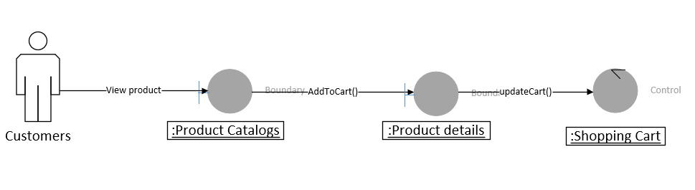
Collaboration Diagram
Collaboration diagram for add to shopping cart

Slide 37
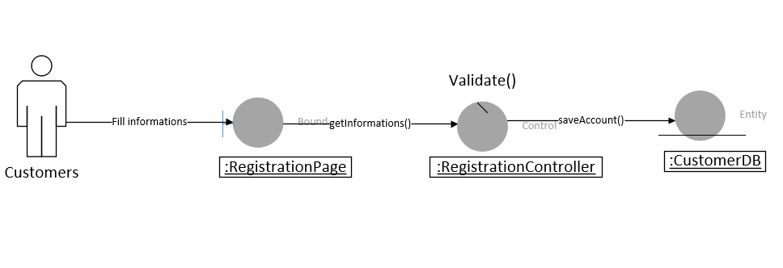
Collaboration Diagram
Collaboration diagram for registration

Slide 38
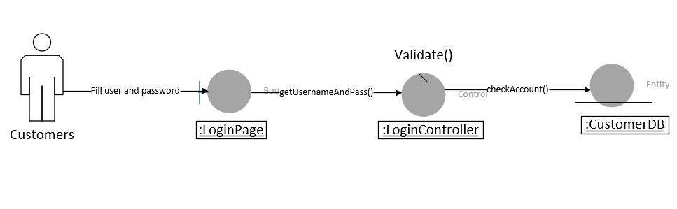
Collaboration Diagram
Collaboration diagram for login

Slide 39
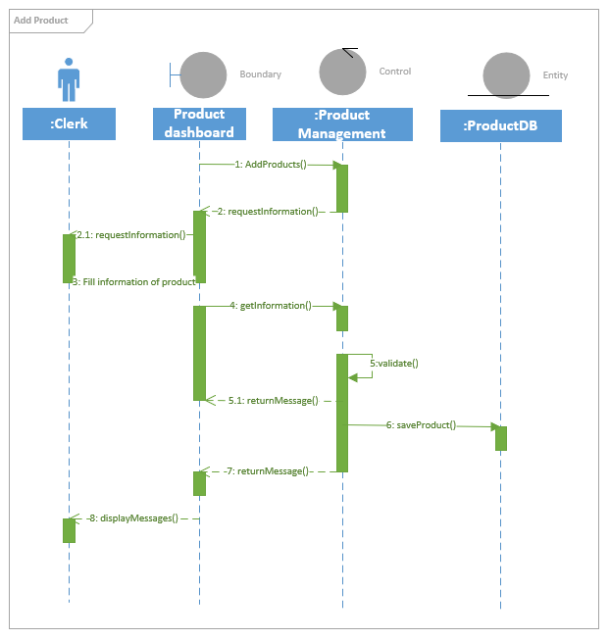
Sequence Diagram
Sequence diagram
for add product

Slide 40
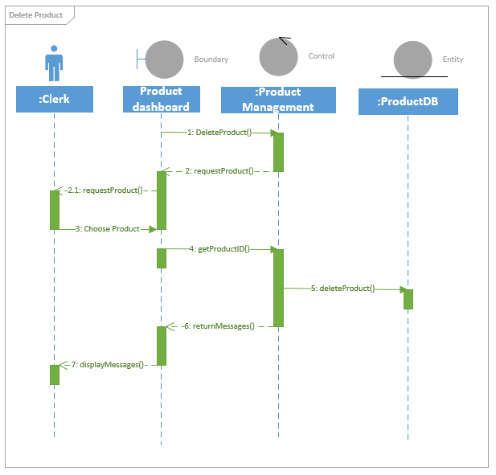
Sequence Diagram
Sequence diagram
for delete product

Slide 41
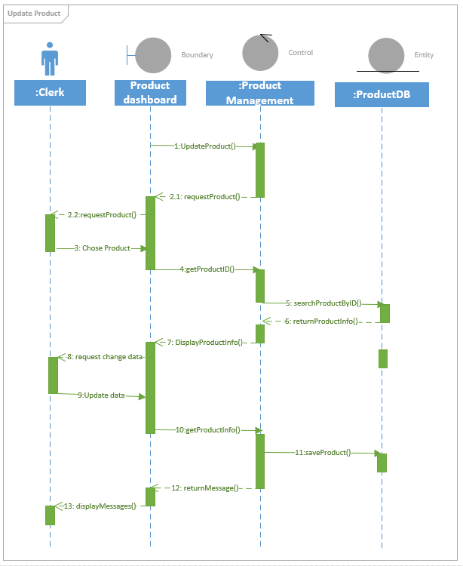
Sequence Diagram
Sequence diagram
for update product

Slide 42
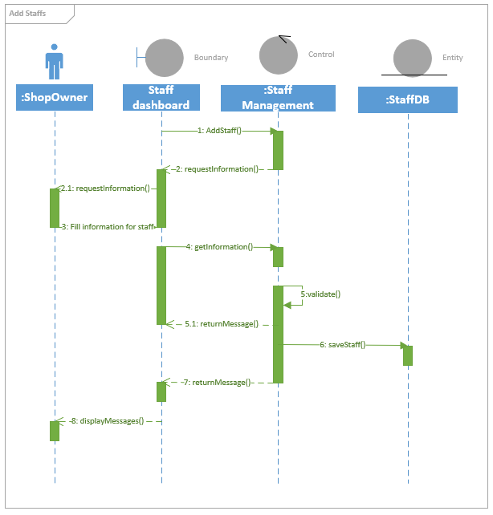
Sequence Diagram
Sequence diagram
for add staff

Slide 43
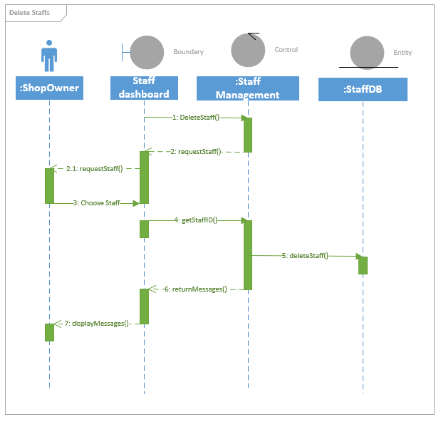
Sequence Diagram
Sequence diagram
for delete staff

Slide 44
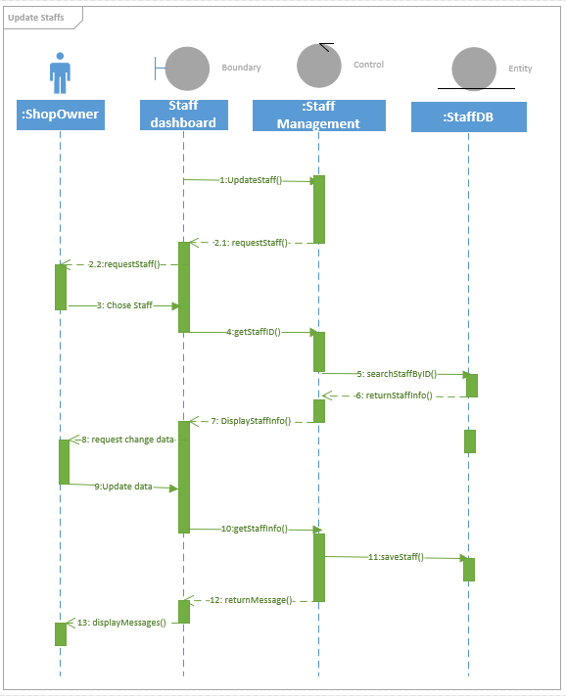
Sequence Diagram
Sequence diagram for
update staff

Slide 45
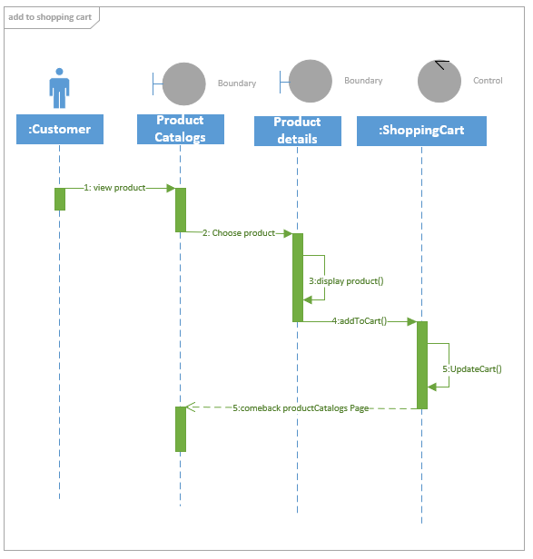
Sequence Diagram
Sequence diagram for
add to shopping cart

Slide 46
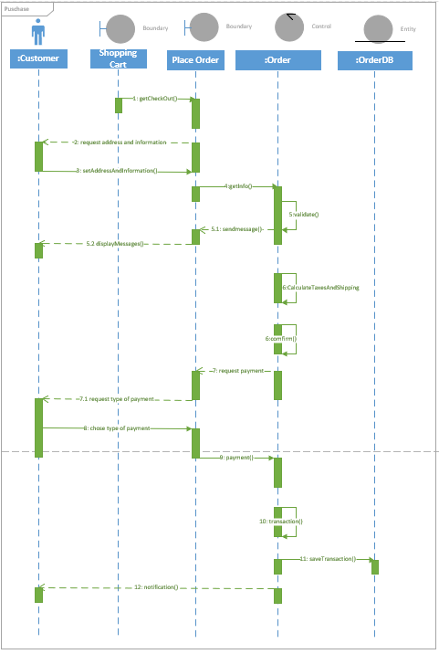
Sequence Diagram
Sequence diagram for purchase

Slide 47
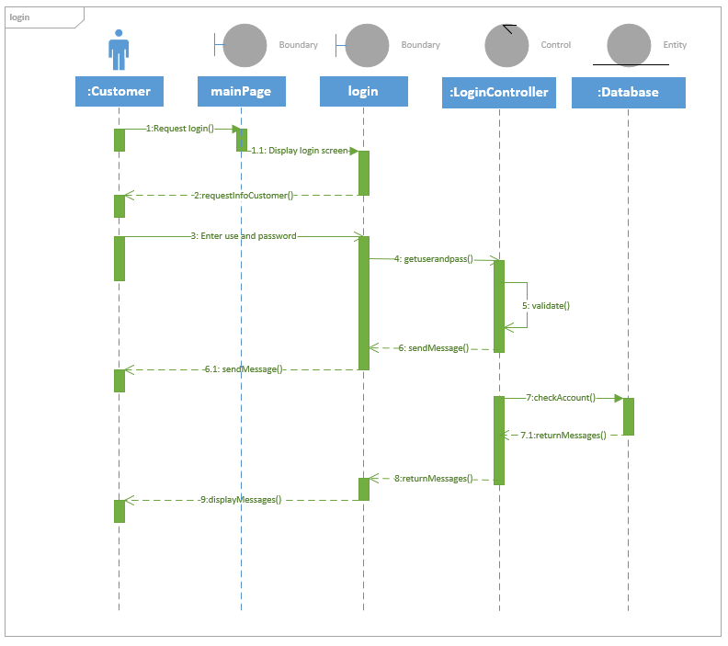
Sequence Diagram
Sequence diagram
for login

Slide 48
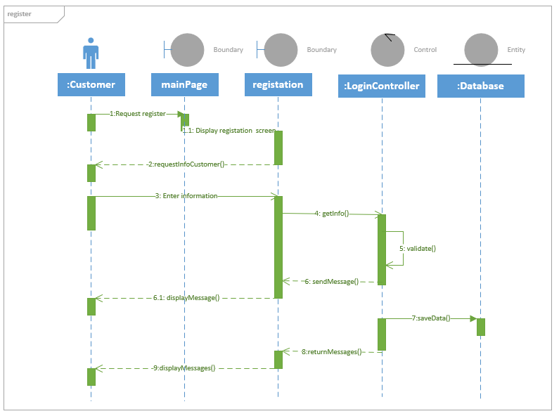
Sequence Diagram
Sequence diagram
for register

Slide 49
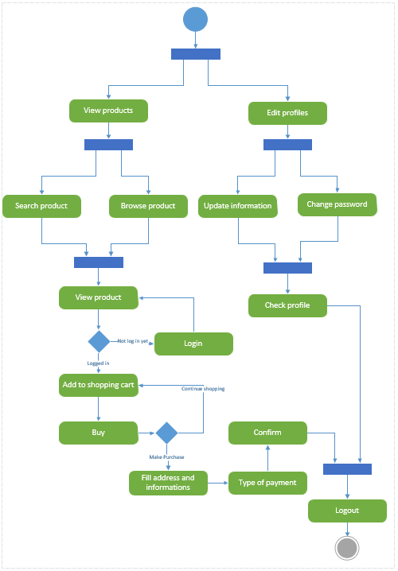
Activity Diagram
Activity diagram for customer

Slide 50
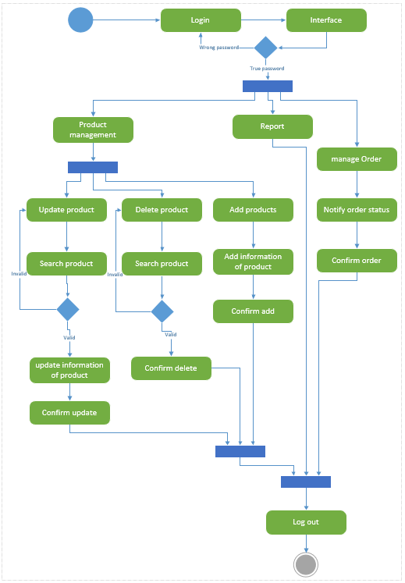
Activity Diagram
Activity diagram for clerk

Slide 51
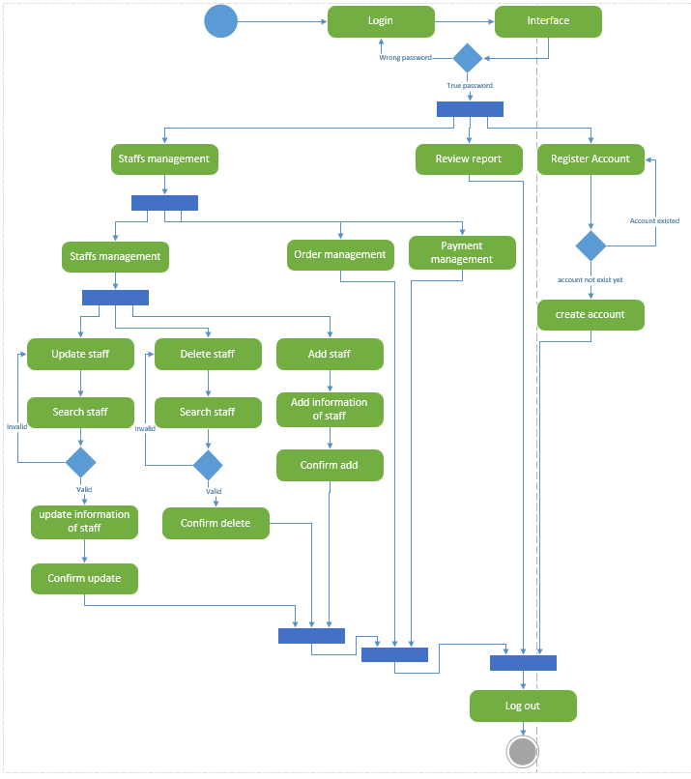
Activity Diagram
Activity diagram for
Shop Owner

Slide 52
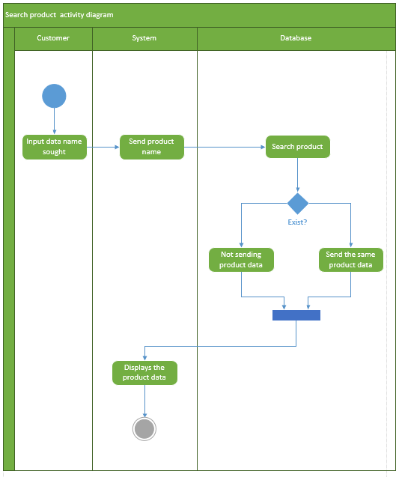
Activity Diagram
Activity diagram for
Search product

Slide 53
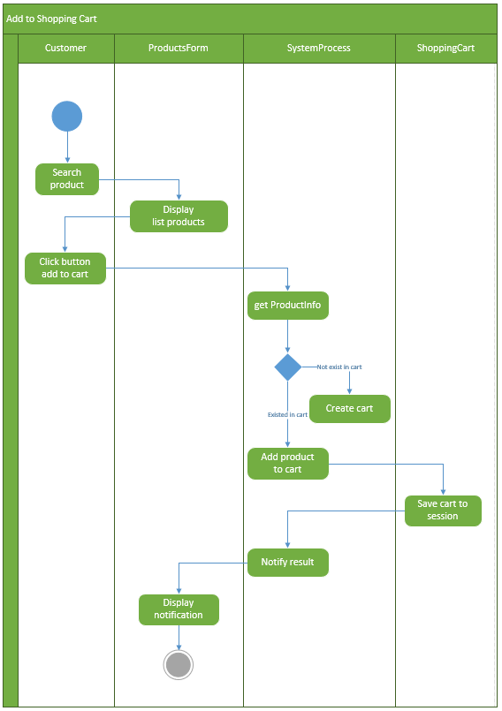
Activity Diagram
Activity diagram for
Add to shopping cart

Slide 54
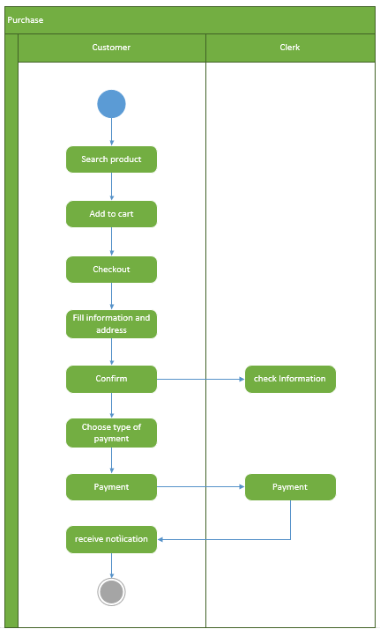
Activity Diagram
Activity diagram for purchase

Slide 55
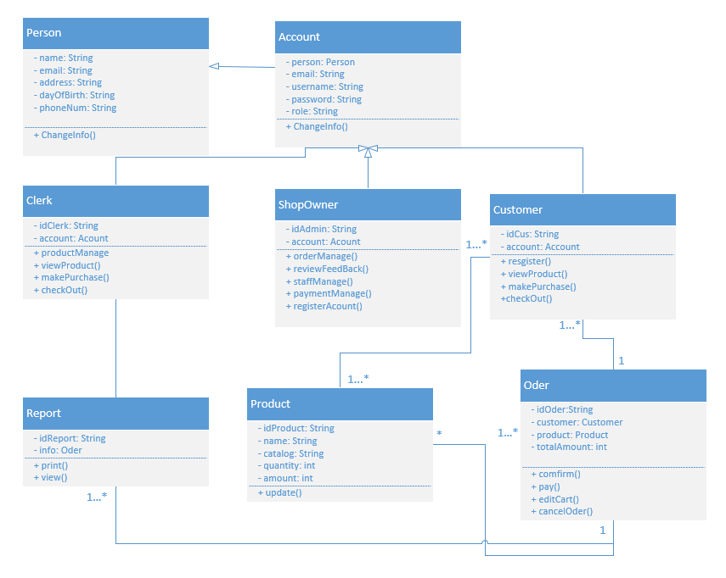
Class Diagram
Class diagram for
Jewelry online
shopping

Slide 56
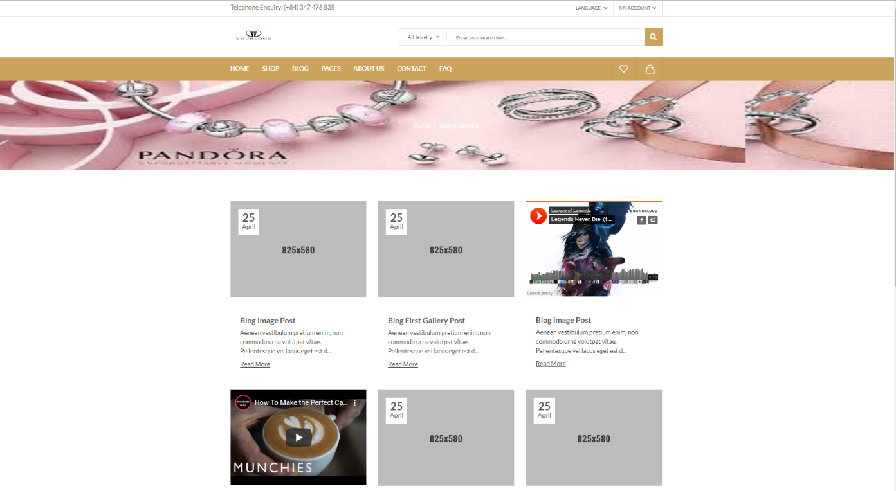
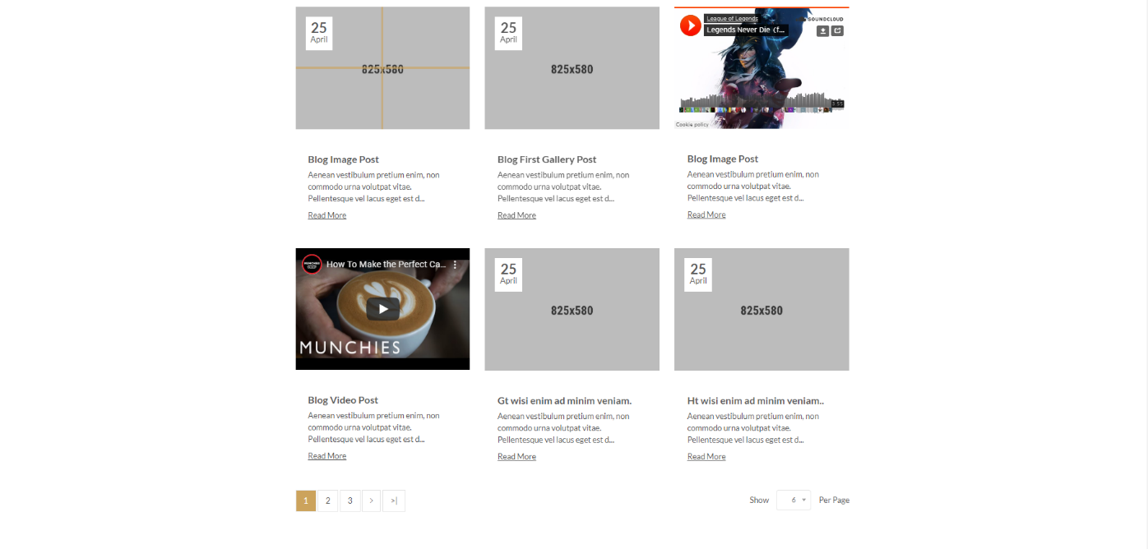
UI Design
UI of Blog Grid View page

Slide 57
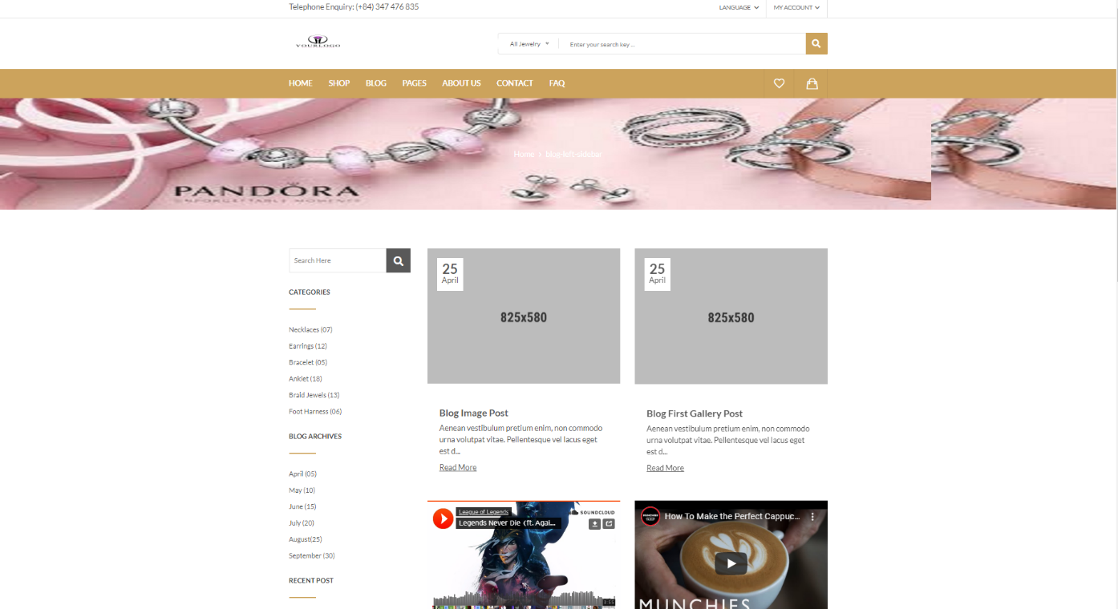
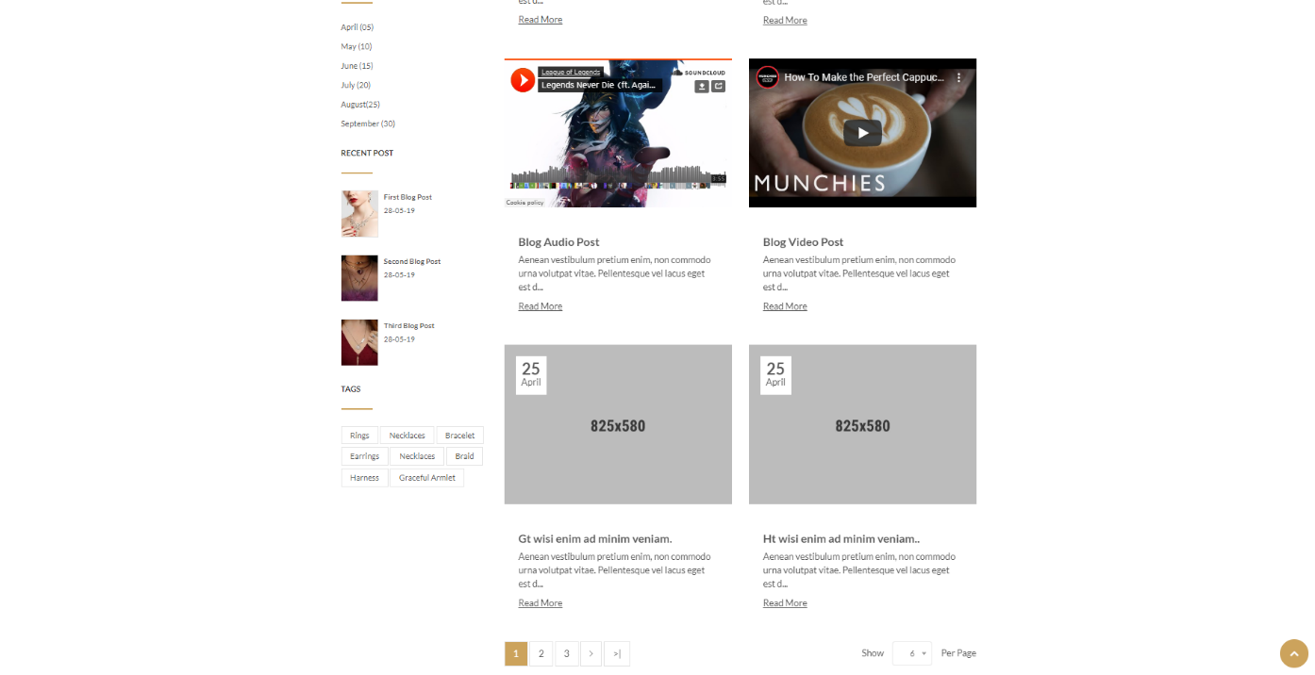
UI Design
UI of Blog Left Sidebar page

Slide 58
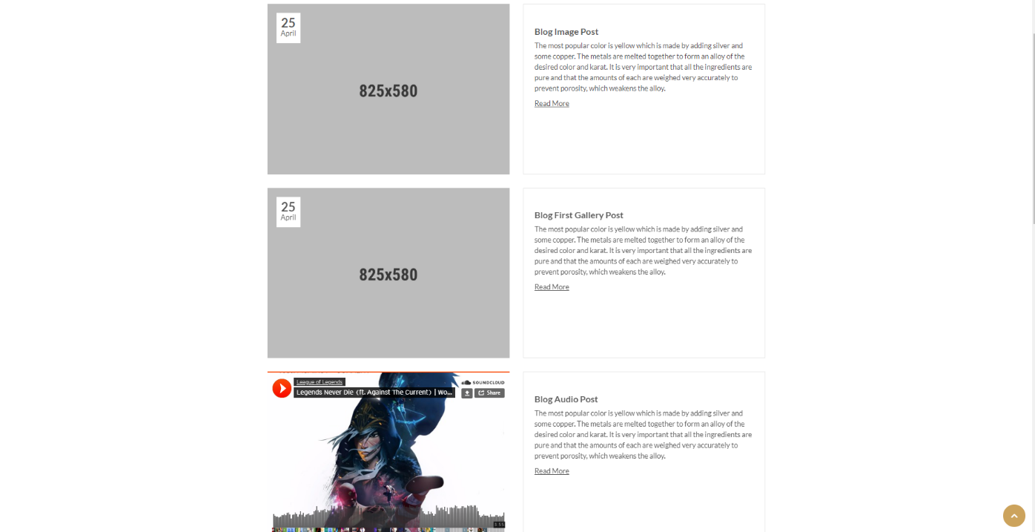
UI Design
UI of Blog List View page

Slide 59
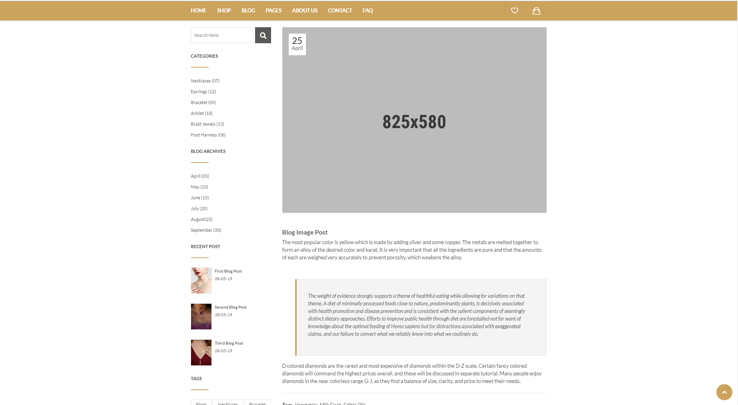
UI Design
UI of Detail’s Blog page

Slide 60
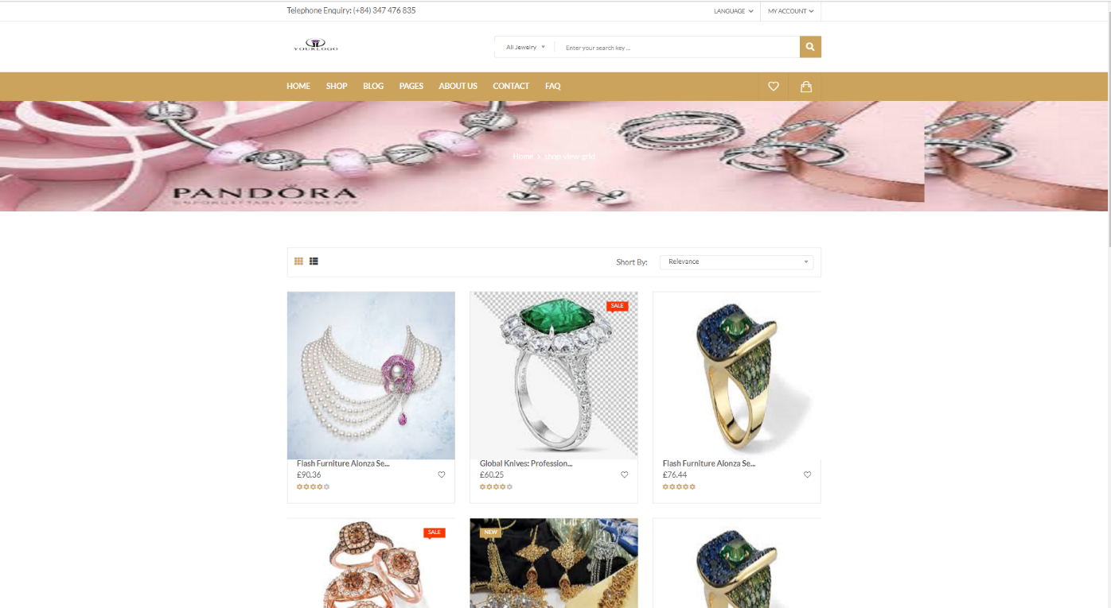
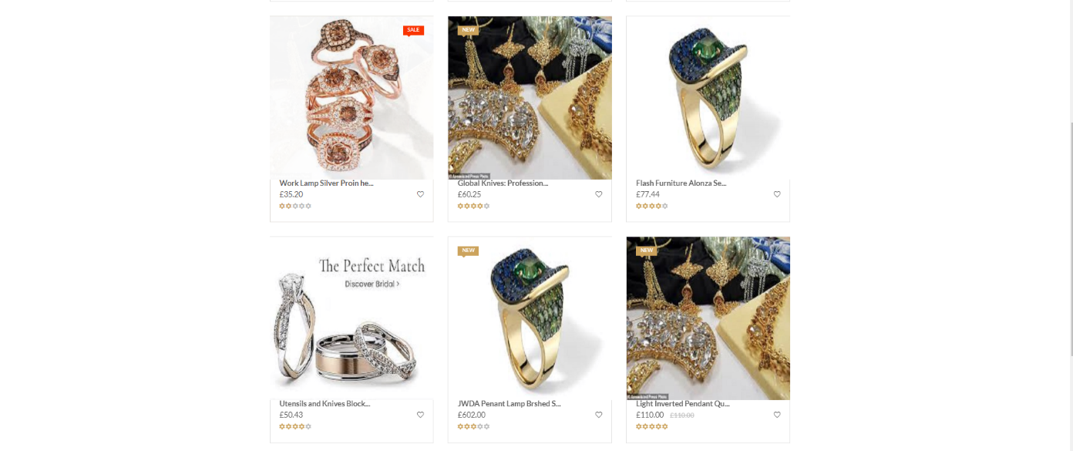
UI Design
UI of Shop Grid View page

Slide 61
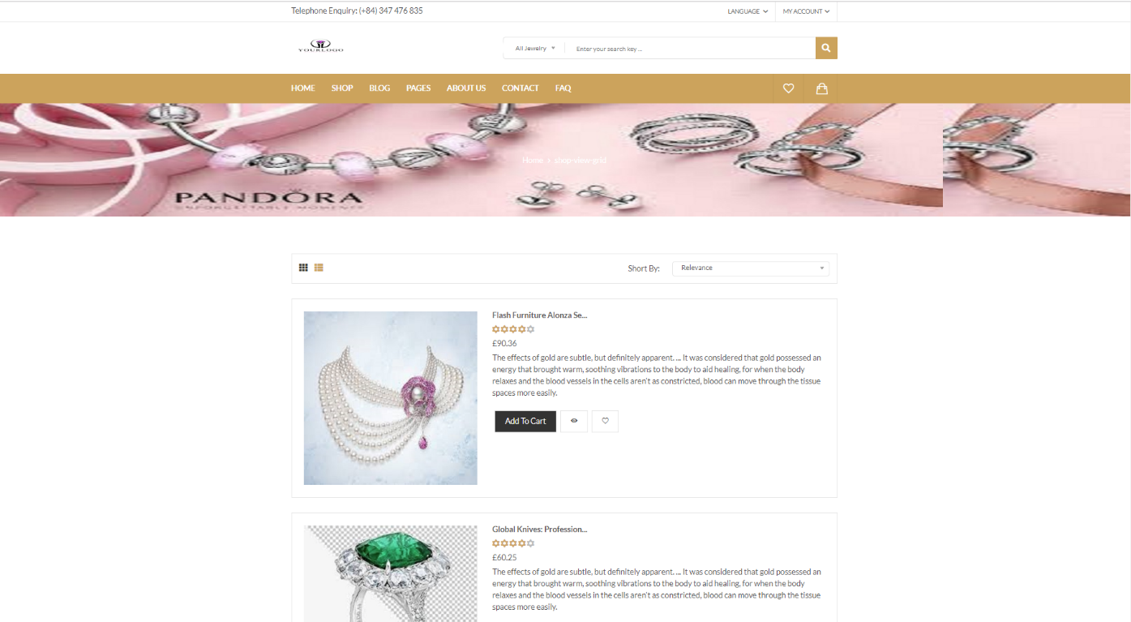
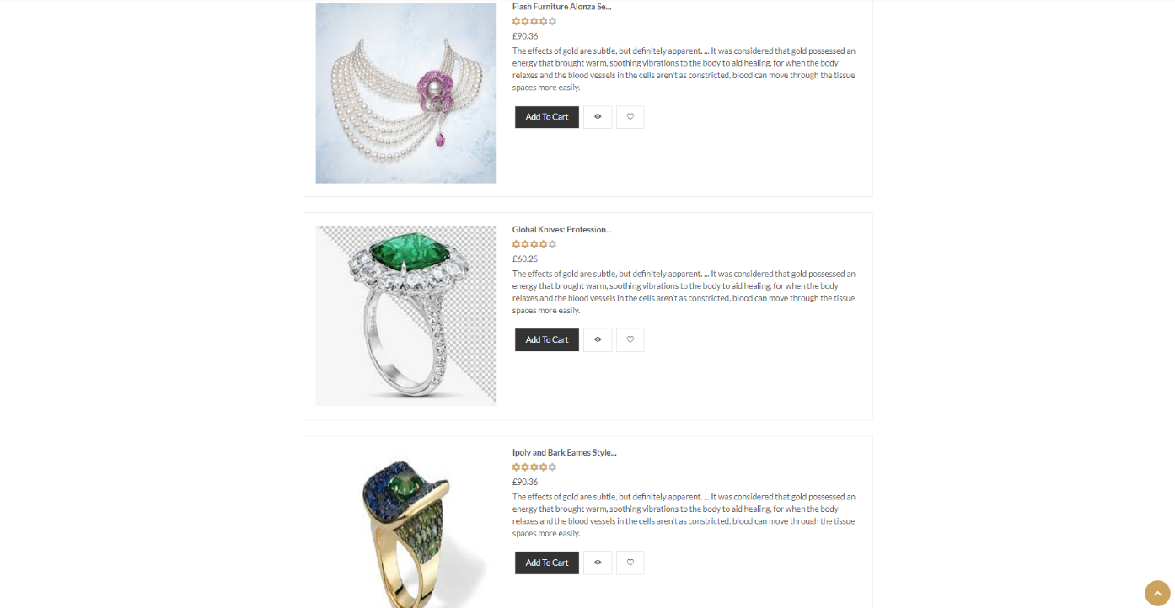
UI Design
UI of Shop List View page

Slide 62
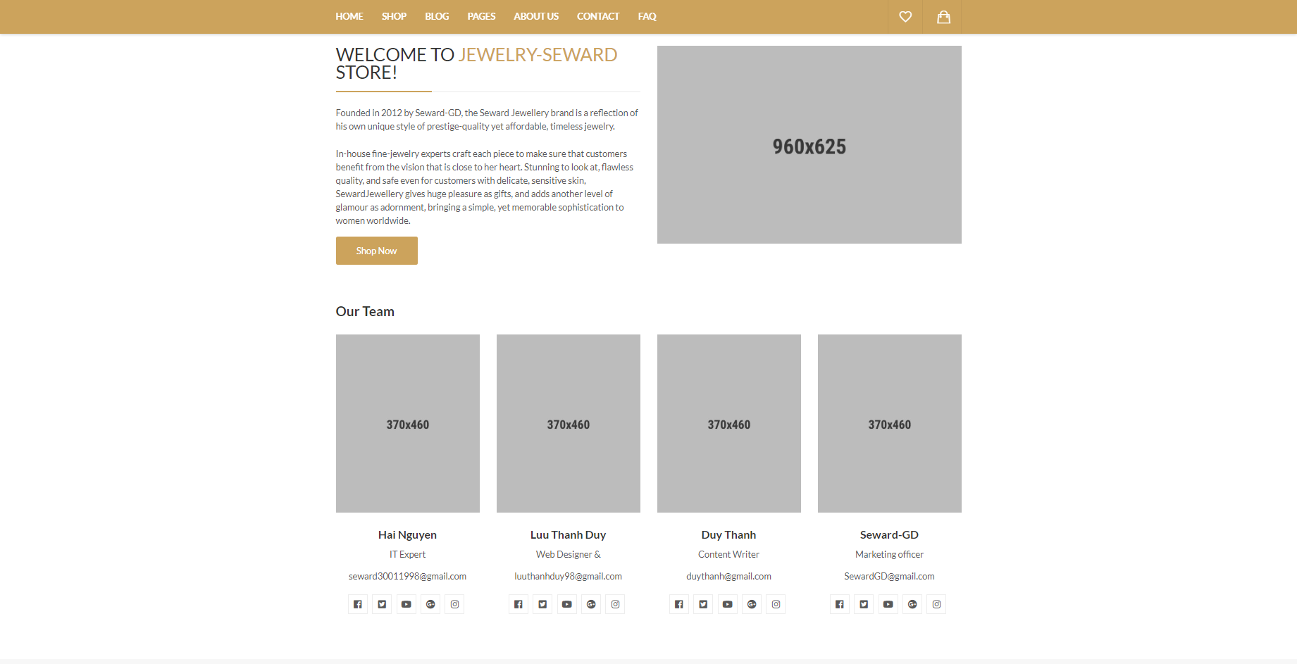
UI Design
UI of About Us page

Slide 63
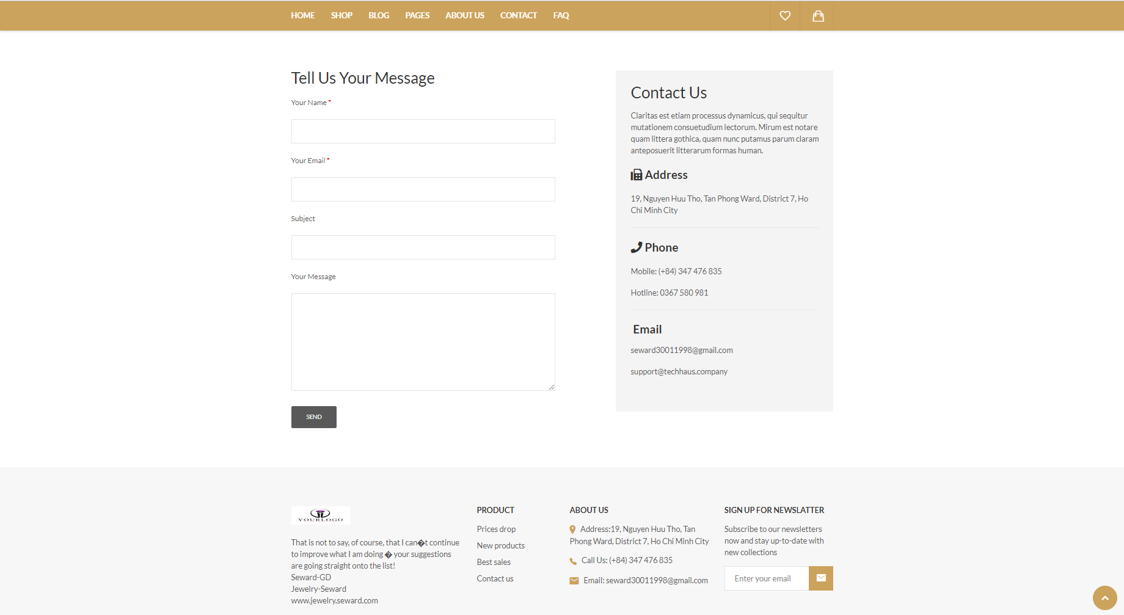
UI Design
UI of Contact page

Slide 64
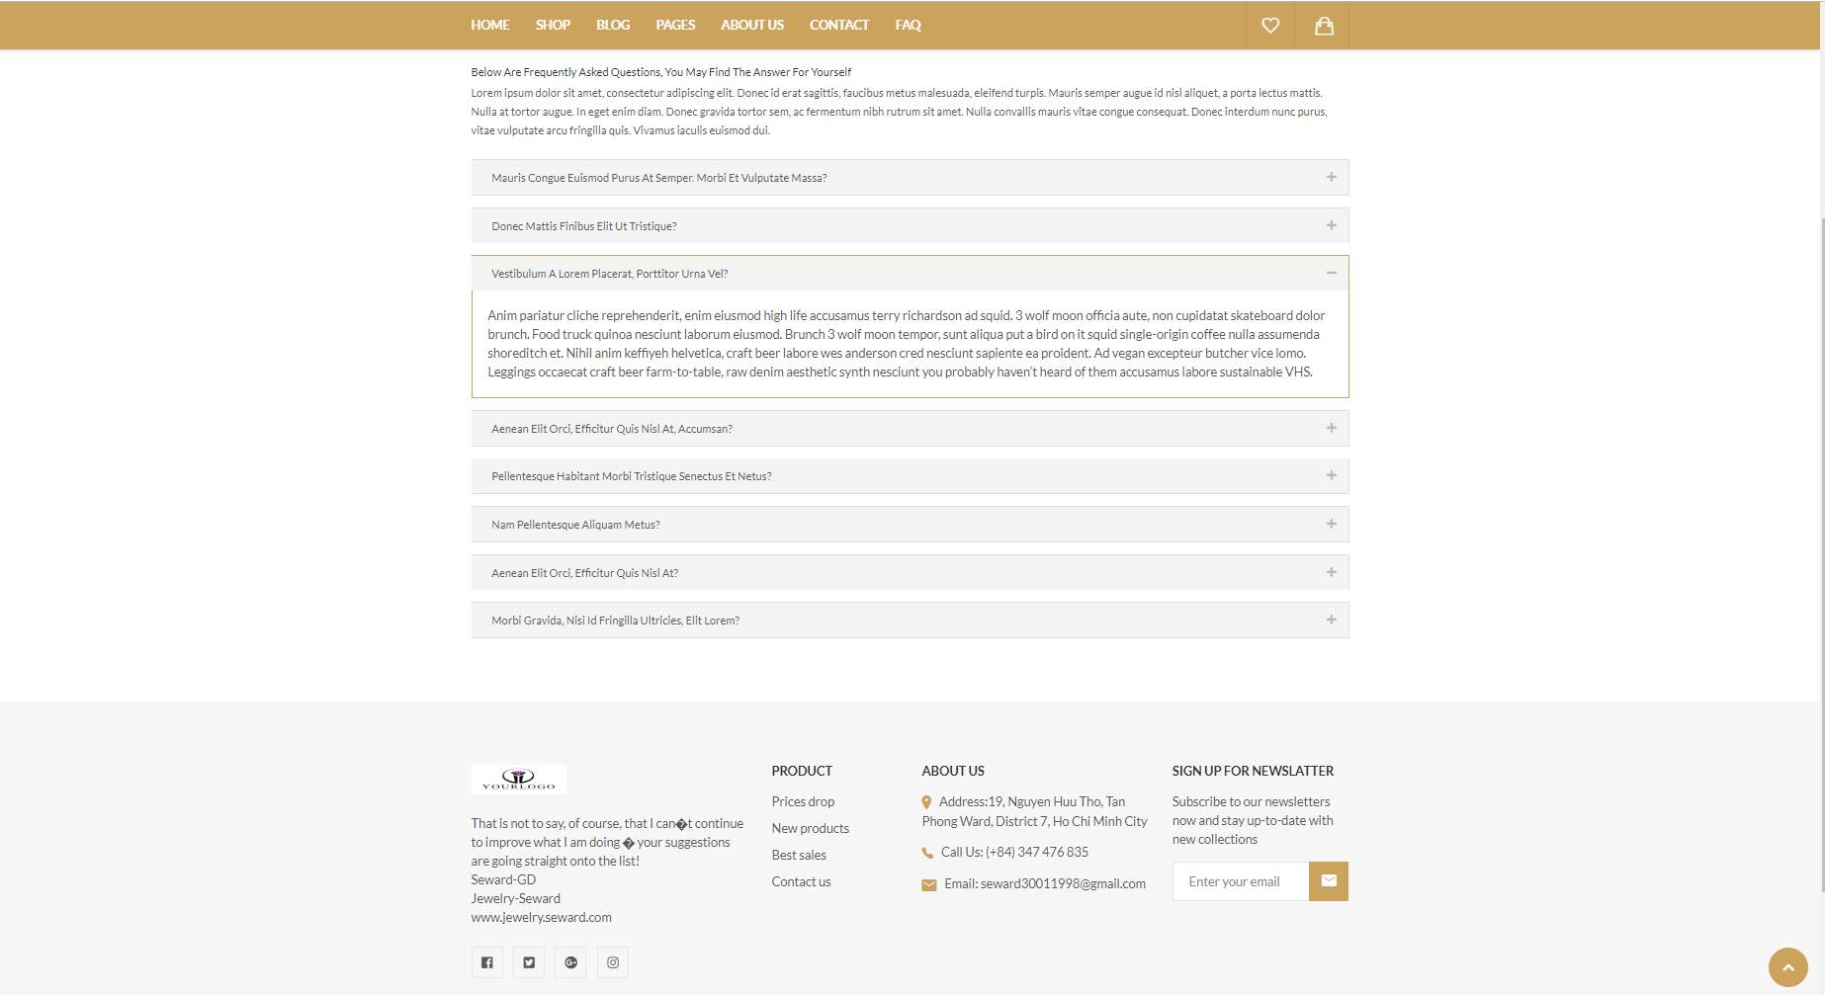
UI Design
UI of FAQ page

Slide 65
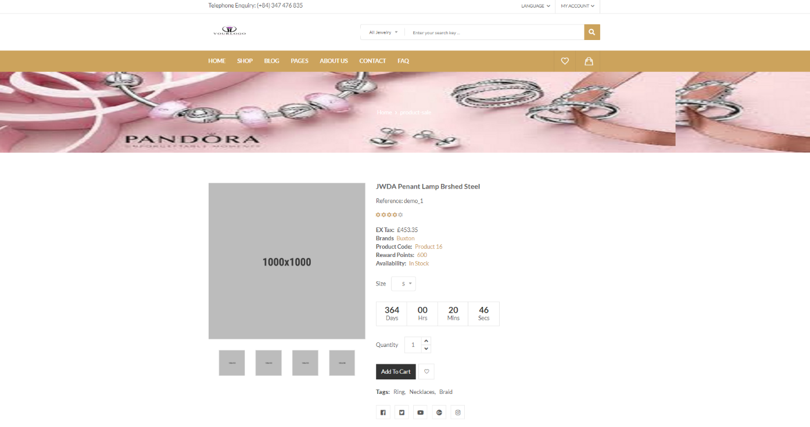
UI Design
UI of Sale Product Details page

Slide 66
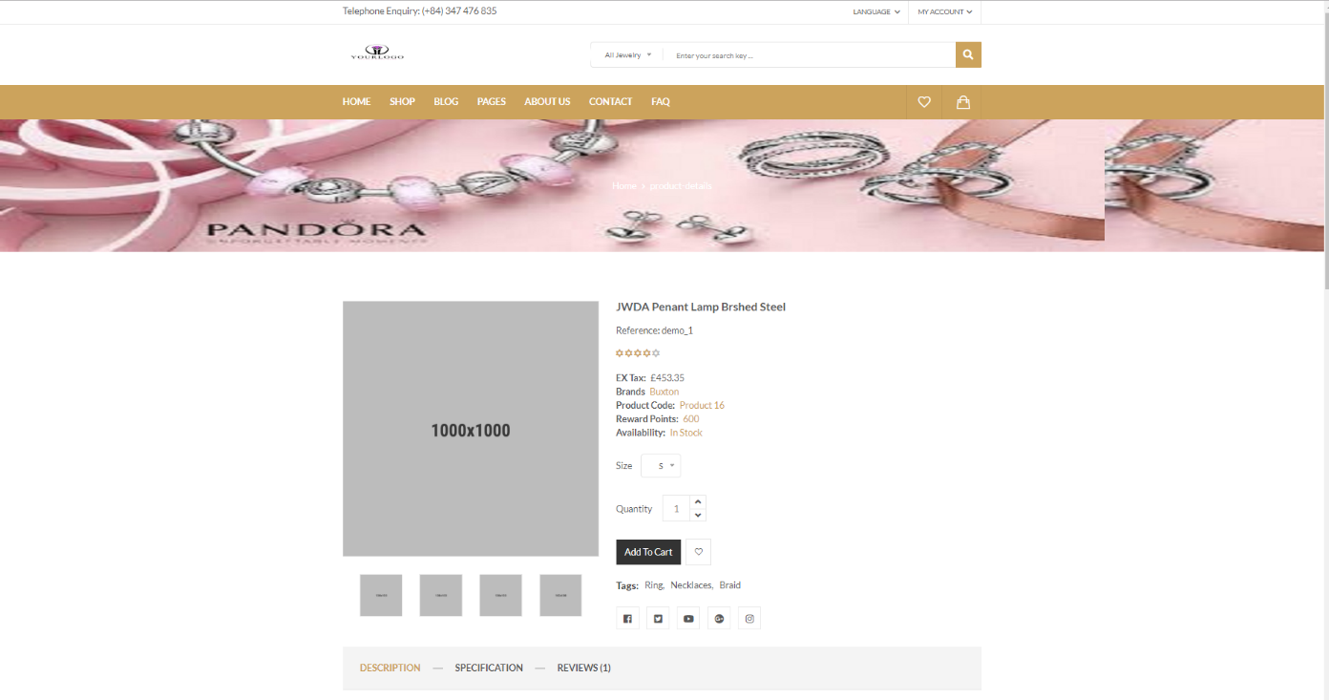
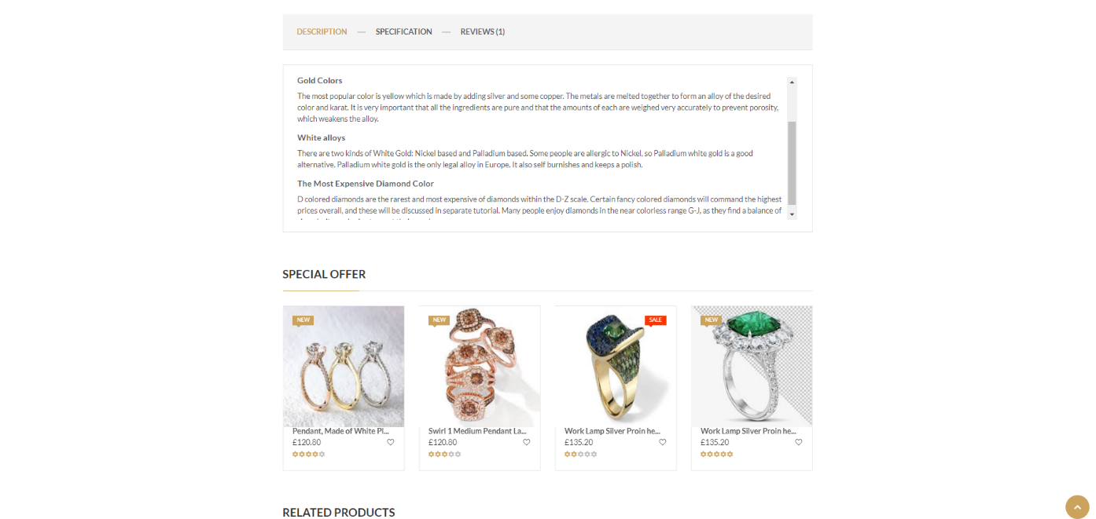
UI Design
UI of Detail Product page

Slide 67
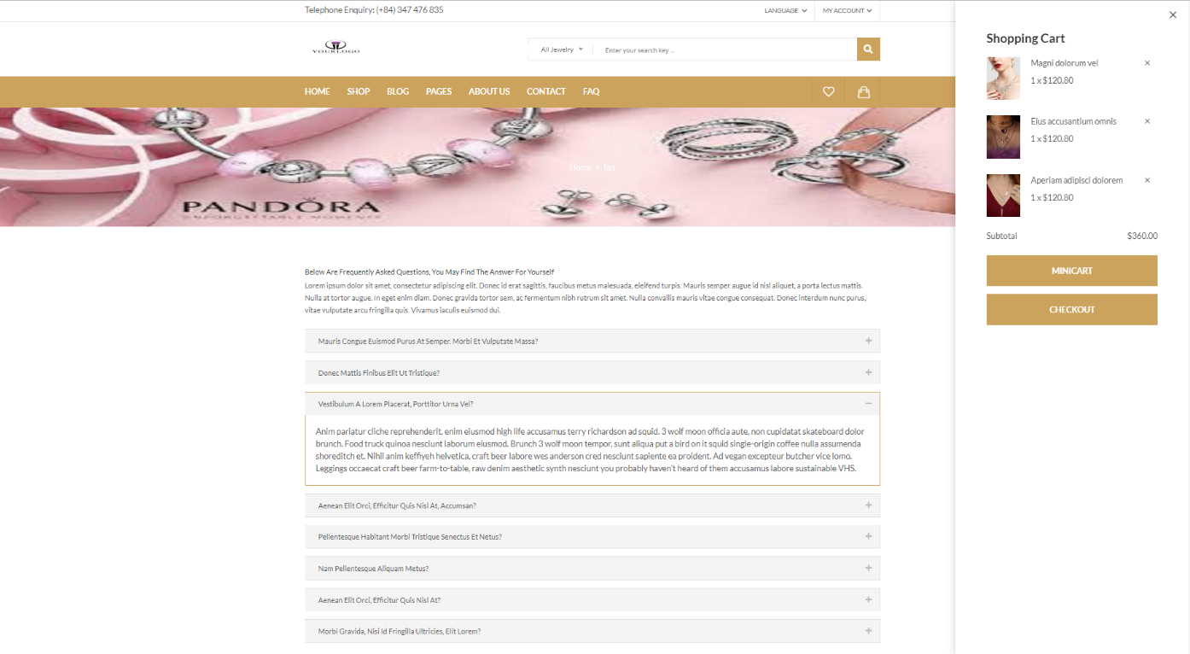
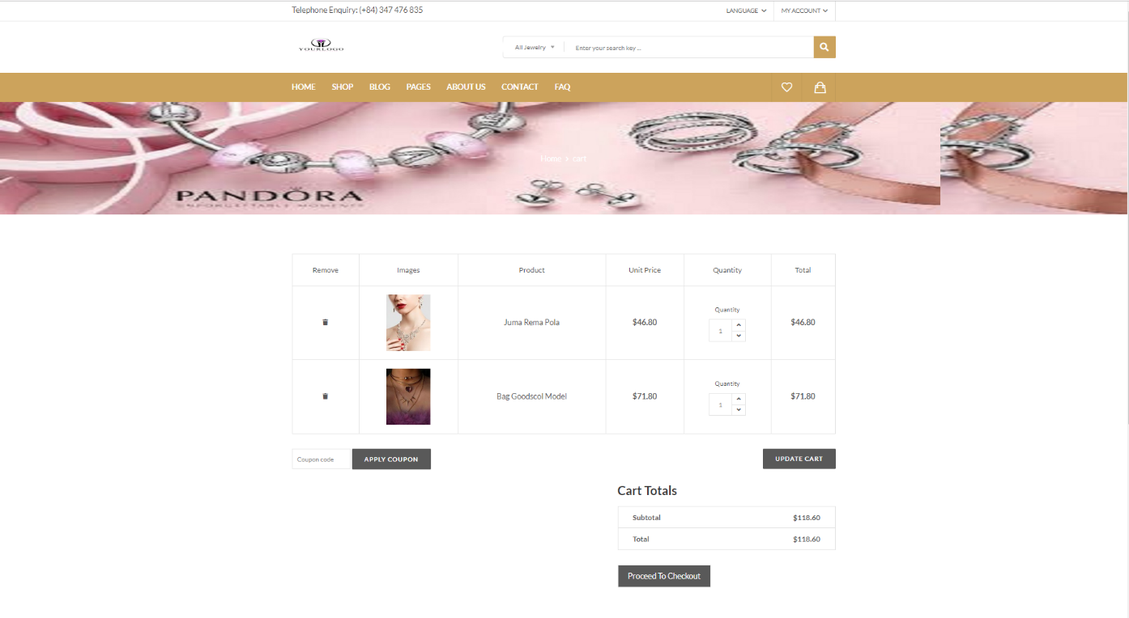
UI Design
UI of Shopping Cart page

Slide 68
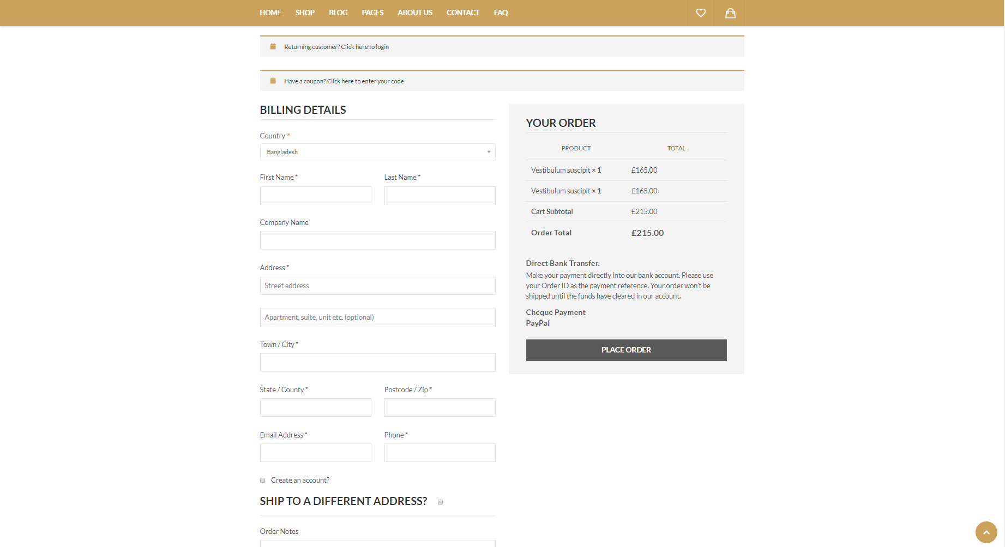
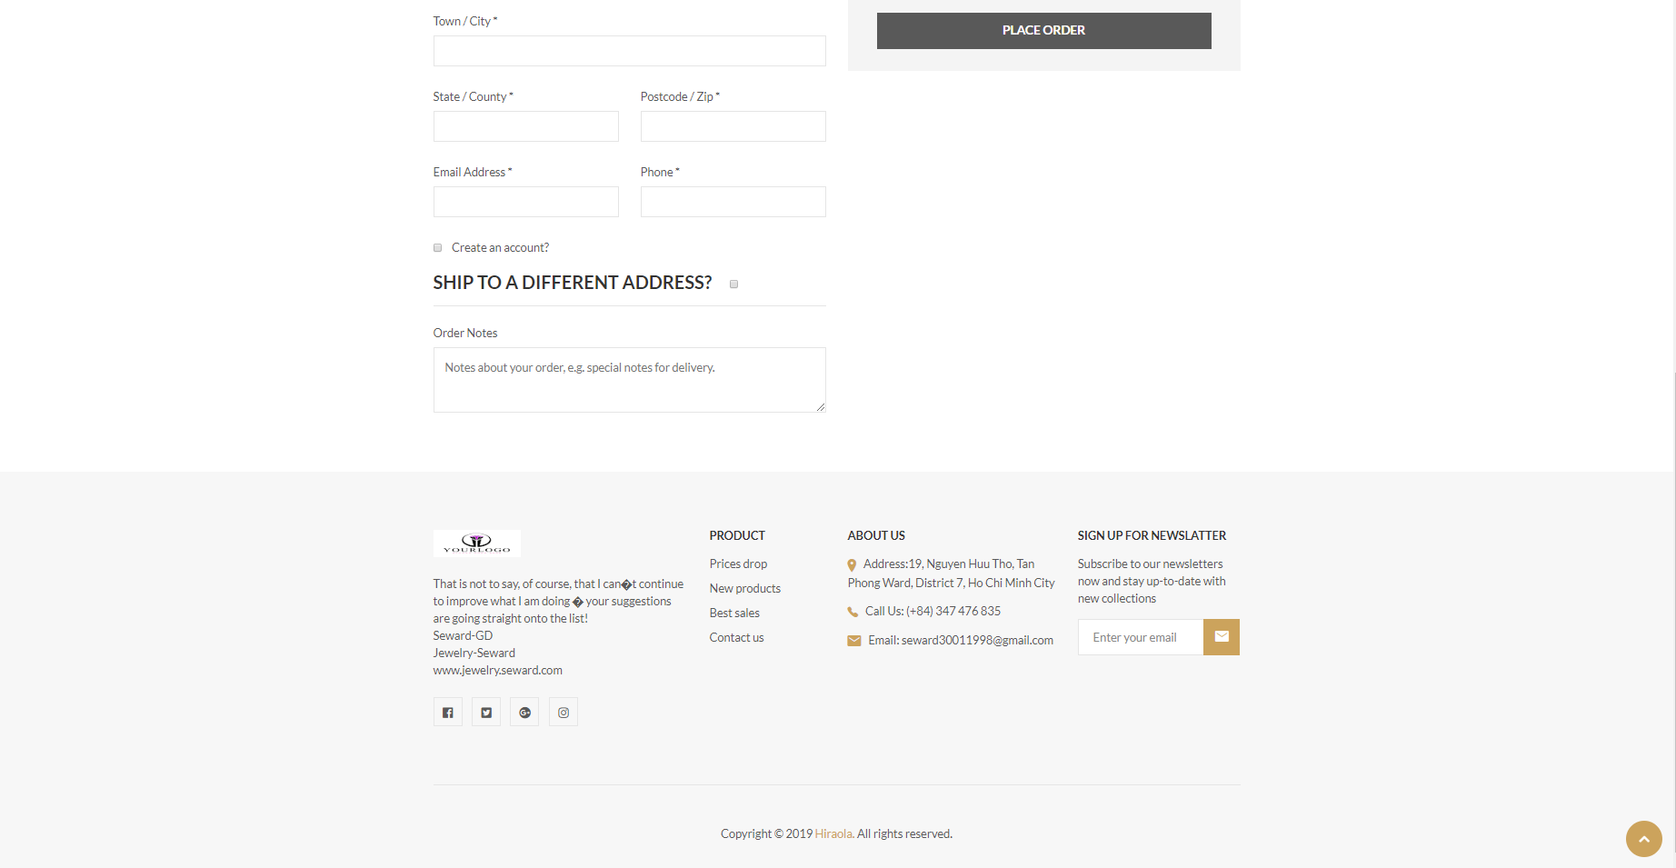
UI Design
UI of Checkout page

Slide 69
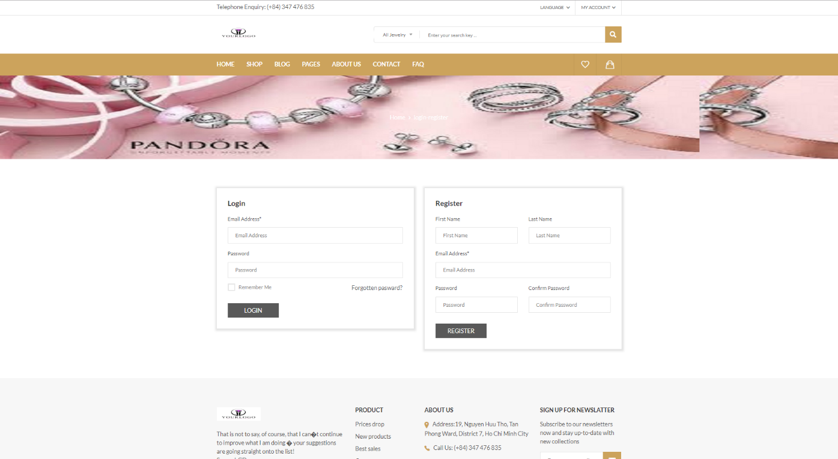
UI Design
UI of Login and Register page

Slide 70

UI Design
UI of Error page

Slide 71
CONCLUSIONS/RECOMMENDATIONS
This sale system is just a functional process without complicated process so far.
The identified actors play an important role to the full functioning of the business.
The output product seems to satisfy all users but will certainly have to wait for the real consequences that the new system can produce. This project has been made user-friendly using basic images that allow users to interact easily with the database.
Finally, we would like to thank everyone who supported us in completing this project.

Slide 72
Thank you for listening!

